Slide 1

Crop Data Analysis of Indian Region using Big Data Techinques for aiding Indian Farmers with Emergencies Alert
Submitted By:
Vineet Rathor (171500382)
Aman Sharma(171500033)
Ashutosh Anand (171500064)

Slide 2
Contents
What is Big Data
Introduction
Dataset
Implementation of Dataset
Methodology
User Interface
Future Prospective

Slide 3

Big Data
Big data is a field that treats ways to analyze, systematically extract information from, or otherwise deal with data sets that are too large or complex to be dealt with by traditional data-processing application software.

Slide 4
Introduction
Farming is the backbone of the country.
Government is taking many initiatives to increase production in farming and also profit for farmers.
We will tell the farmers which crops are beneficial for them in which season which crop should they grow based upon the humidity, temp., soil type, pH value and many other factors.
This project also provides real time data of covid-19 cases & other natural calamities based upon the farmer’s location and also work as an emergencies alert.

Slide 5
Dataset
Main Data source : https://data.gov.in/
Main Columns are : State, District, Season, Crop, Area & Production.
We added a new column of production per area.
Imported the data into MongoDB from CSV file.
Covid-19 API
https://covid-19-india-data-by-zt.p.rapidapi.com/GetIndiaDistrictWiseDataForState

Slide 6
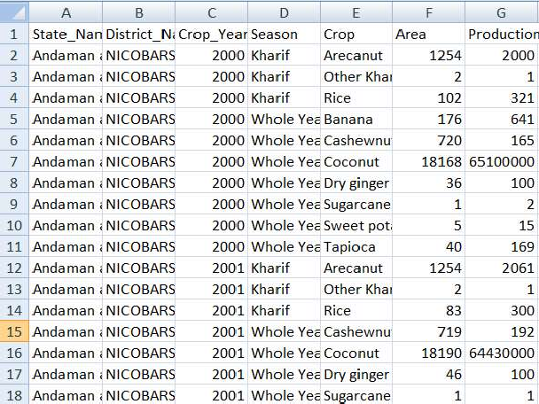
Fig. Initial Dataset

Slide 7
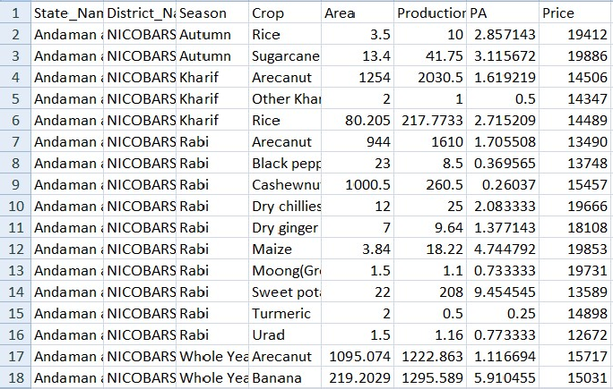
Fig. Updated Dataset

Slide 8
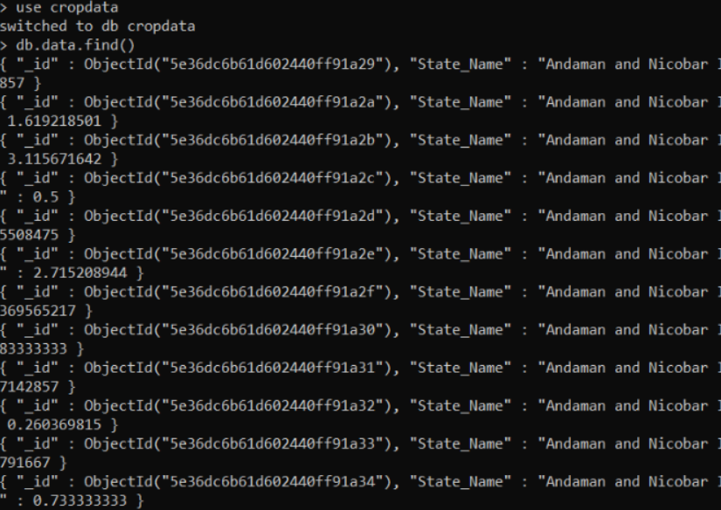
Implentation of Dataset
Used the command Mongo Import to import the dataset into MongoDB:-
mongoimport -d cropdata -c data --type csv --file finalcrops.csv --headerline

Slide 9
Methodology
We took the data from data.gov.in and cleaned it.
Transferred the data into mongoDB.
Connection of database with node.js used Express to create local server.
Embedded queries of mongoDB into node.js.
Displaying results on the basis of queries of farmers.
Lastly, we also showed the number of active cases, confirmed cases and recovered cases of covid-19 bases upon the farmer’s location or the inputted query.

Slide 10
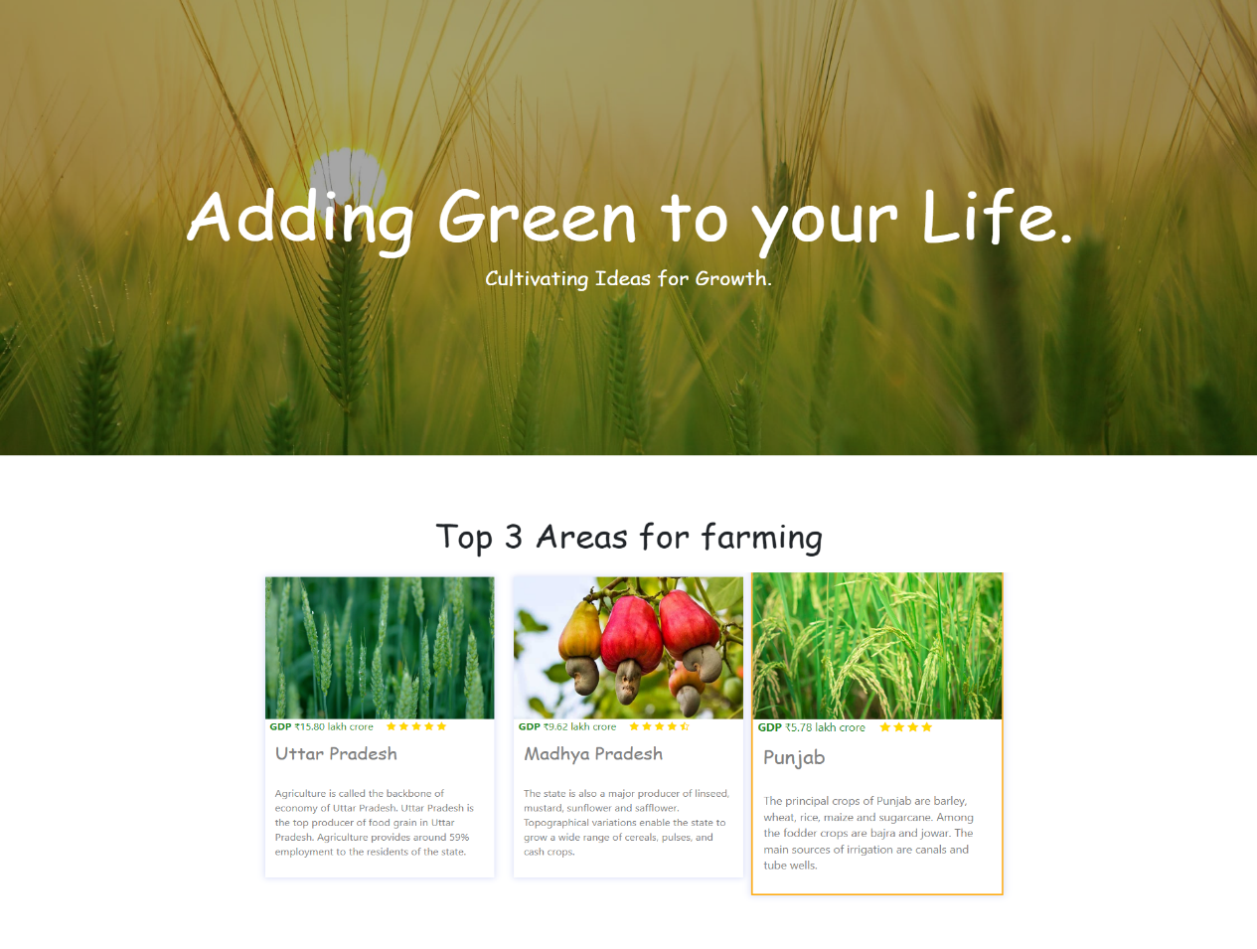
User Interface
Starting Page

Slide 11
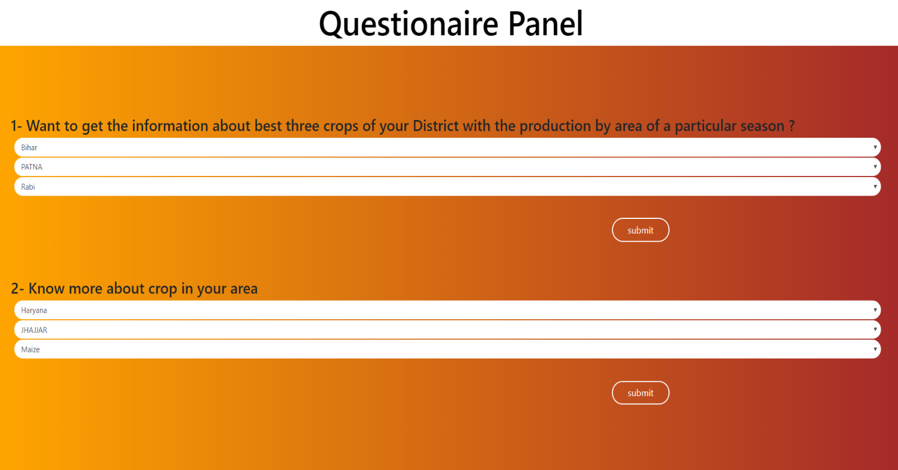
Questionnaire Panel asks about your area and crop you want to grow.

Slide 12
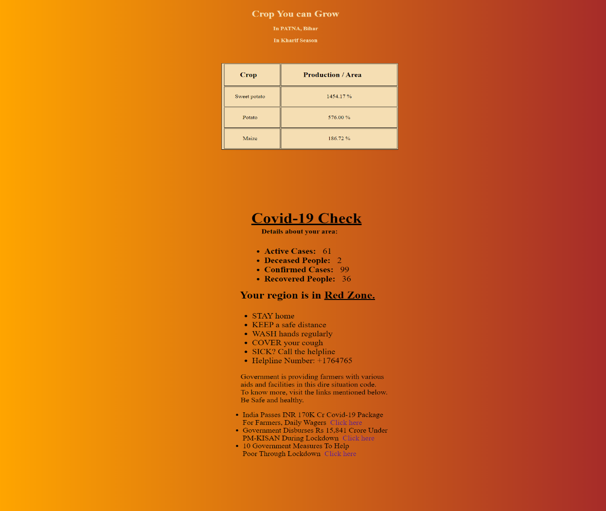
Gives information about the crops you can grow efficiently in the area and also the status about the covid-19 in that area

Slide 13
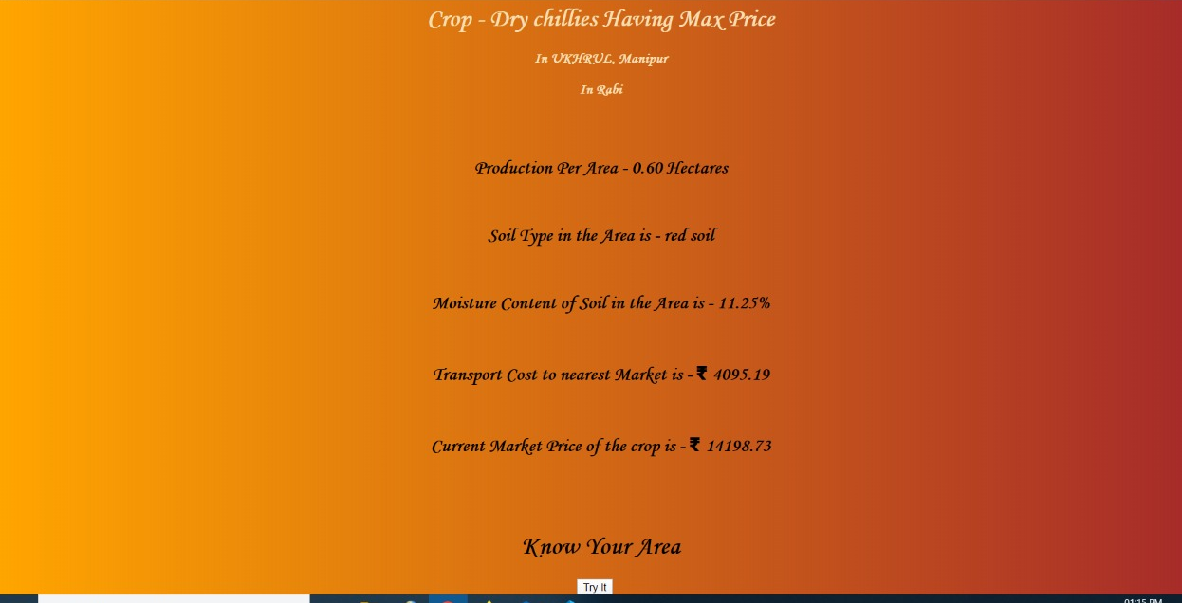
Show the cost analysis of the crop like transportation cost and market price. Also, other information like soil type and moisture content.

Slide 14
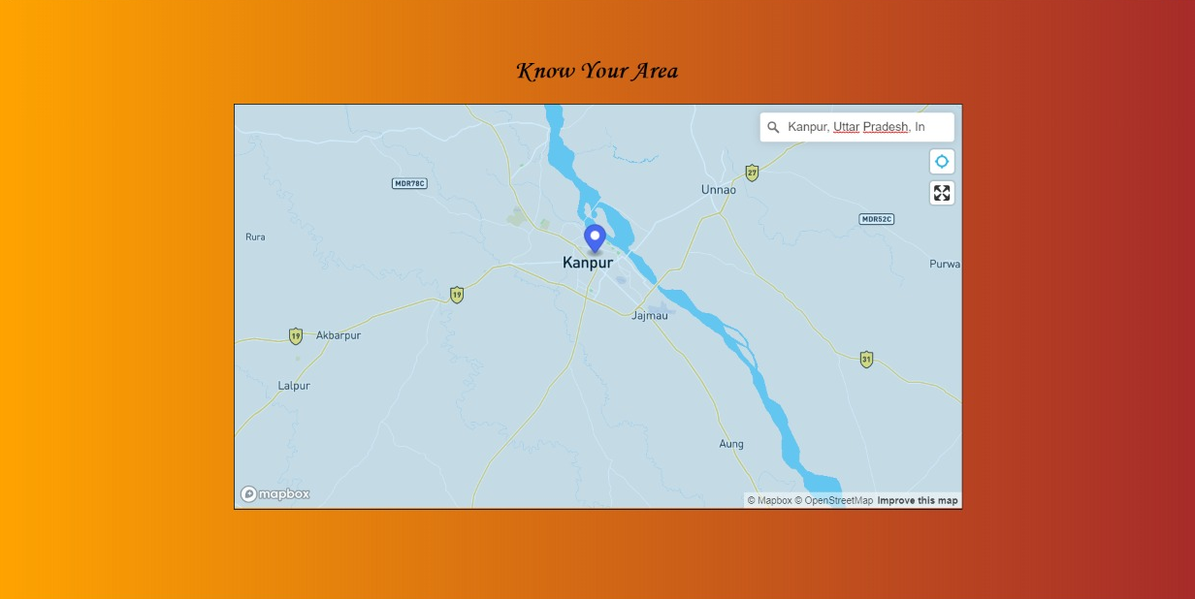
Shows the area in google maps.

Slide 15
Future Prospective
Currently, we are able to display the top three crops of farmer’s district, by which he will be able to decide which crop he should grow.
We are planning to show the prices of the market for that crop which he wants to grow by using the real time data provided by government.
We will try to also make an app of this website so that farmers can get information by using GPS and it would be even less work on their part and they can also be informed for emergencies by sending push notifications rather than opening the website to see them.

Slide 16
Thank You

